Slide 1
Module2 Day1: Network Analysis
Hannah Carter
UCSD Department of Medicine
03/08/2016

Slide 2
Overview
Day 1: Network analysis
Network basics
Examples of biological networks
Networks & variant analysis
Networks & expression analysis
Exercises
Day 2: Variant prioritization
Refresher on variants
Strategies for prioritization
Existing tools
Exercises

Slide 3

Why Networks?

Slide 4
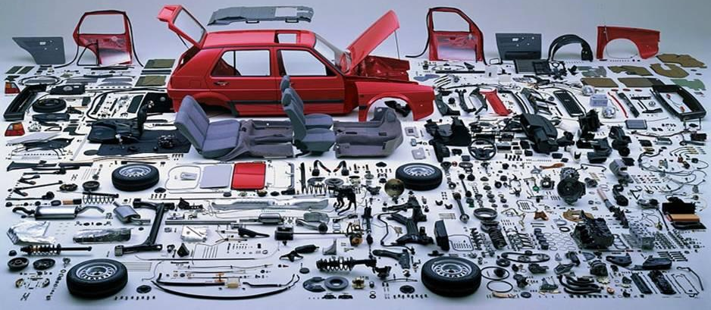

Why Networks?
Reductionist Biology
Parts list
Study each part individually
Systems biology
Study behavior of the system
Behavior arises from interactions among components
Networks capture interactions
Better for studying complex behaviors of systems
Notes:
The study of the interactions between the components of biological systems, and how these interactions give rise to the function and behavior of that system

Slide 5
Network Theory
Study of graphs as a representation of the relationships between discrete objects
Genes, proteins, enzymes, metabolites, drugs, diseases, …
Objects represented as nodes, relationships represented as edges
Protein-protein interactions, enzyme-substrate relationships, co-expressed mRNAs …

Slide 6
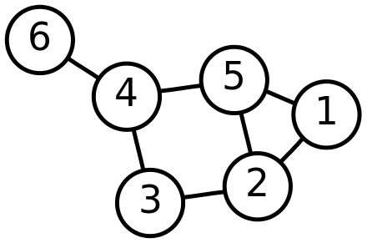
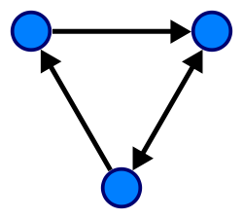
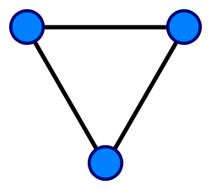
Properties of Graphs
G=(V,E)
V = vertices (nodes)
E = edges
Nodes can represent one type of entity or two
Bipartite graph
Edges can be directed or undirected (or mixed)
Subgraph – subset of G
V = {1, 2, 3, 4, 5, 6}
E = {{1, 2}, {1, 5}, {2, 3}, {2, 5}, {3, 4}, {4, 5}, {4, 6}}

Slide 7
Properties of a Graph
Degree
The number of edges incident on a node
In a directed graph can be divided into in-degree and out-degree
Walk
A sequence of adjacent vertices in the graph
Can also be thought of as a sequence of incident edges
Path
A walk in which no vertex occurs more than once
Shortest path

Slide 8
Properties of Graphs
Connected components
The set of connected nodes in a graph form a connected component
Graphs can have multiple connected components
Cliques
A set of nodes that are all directly connected to one another
“Complete” subgraph of G
Motifs
Subgraphs that occur within a larger graph
Cyclic vs acyclic
Trees are graphs with no cycles
Nodes can sometimes have self loops

Slide 9
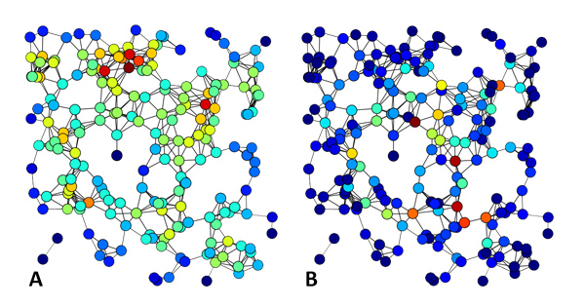
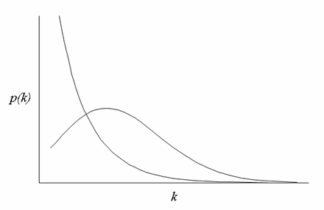
Properties of Graphs
Density – the extent to which a graph is complete
Centrality – identifies the most “important” nodes in a graph
Various measures: degree centrality, betweenness centrality, …
Assortativity – the tendency of similar nodes to interact
Often measured in terms of node degree
Scale-free – degree distribution follows a power law
Small-world – most nodes can be reached from all other nodes by traversing a small number of edges
Betweenness Centrality
Degree Centrality

Slide 10
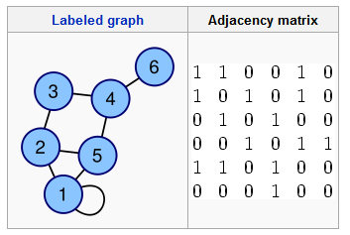
Encoding Graphs
Adjacency matrix
Can include edge weights in adjacency matrix
SIF format
1 1
1 2
1 5
2 3
2 5
3 4
4 5
4 6

Slide 11
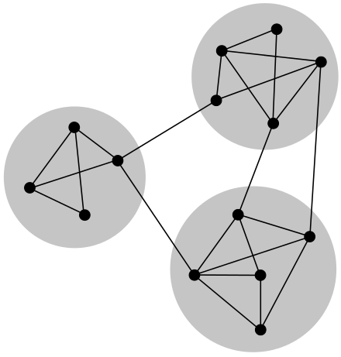
Algorithmic Problems on Graphs
Clique/motif counting
Module/community finding
Shortest path in a weighted or directed graph
Graph partitioning

Slide 12
Statistical Problems on Graphs
Hypothesis testing with networks
Determine if motif is over-represented
Compare behavior of groups of nodes
Test randomness of spatial distributions on the network
Compare properties of two networks
Theoretical null models often not available
Need background of random expectation
"observations" or scores in network data are not "independent" samplings from populations
Violates assumptions of many statistical tests

Slide 13
Statistical Problems on Graphs
Degree-preserving Permutation
Would you expect to see a statistic as extreme as t in a random network WITH THE SAME PROPERTIES?
Corresponds to an adjacency matrix where the row and column sums are the same.

Slide 14
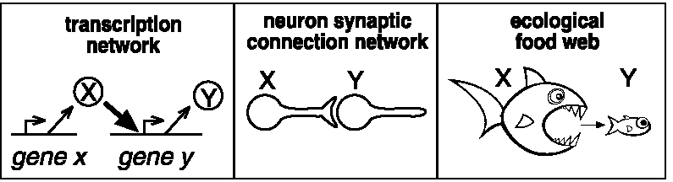
Example: Motif searches in 3 different contexts
How many motifs (connected subgraph topologies) exist involving three nodes?
If the graph is undirected?
If the graph is directed?

Slide 15
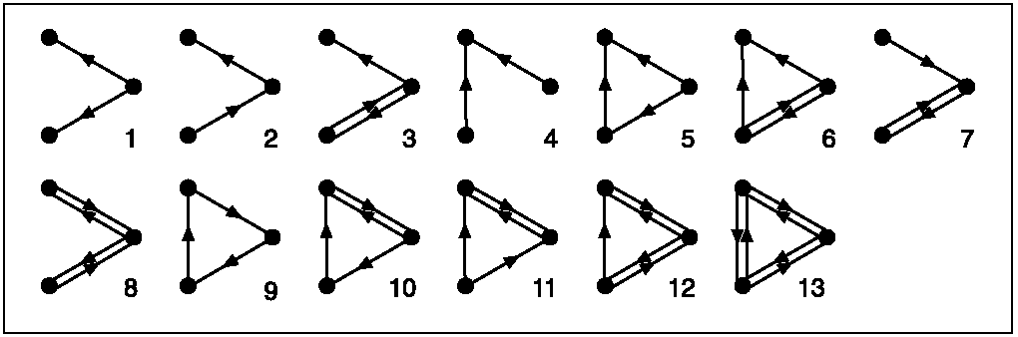
All 3-node directed subgraphs
What is the frequency of each in the network?

Slide 16
Outline of the Approach
Search network to identify all possible n-node connected subgraphs (here n=3 or 4)
Get # occurrences of each subgraph type
The significance for each type is determined using permutation testing, in which the above process is repeated for many randomized networks (preserving node degrees– why?)
Use random distributions to compute a p-value for each subgraph type. The “network motifs” are subgraphs with p < 0.001

Slide 17
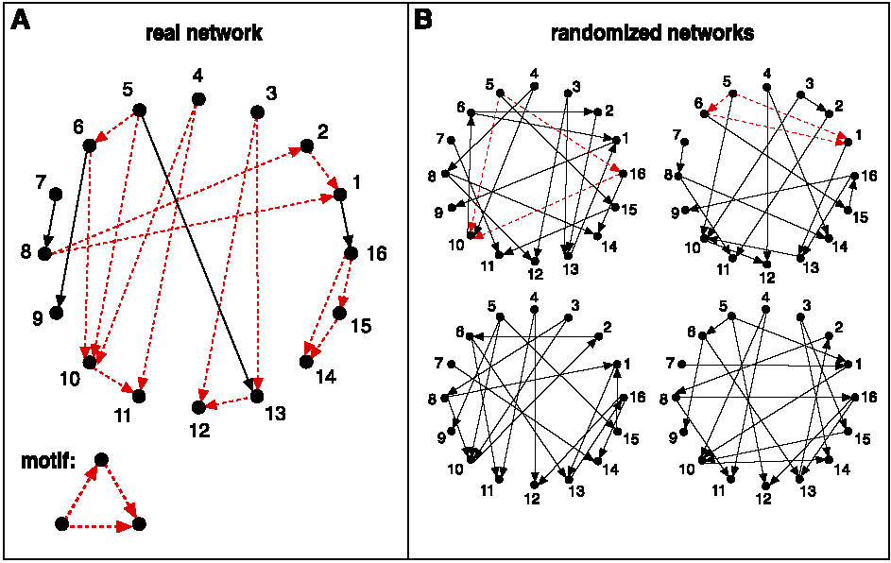
Schematic view of network motif detection
Networks are randomized preserving node degree

Slide 18
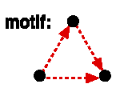
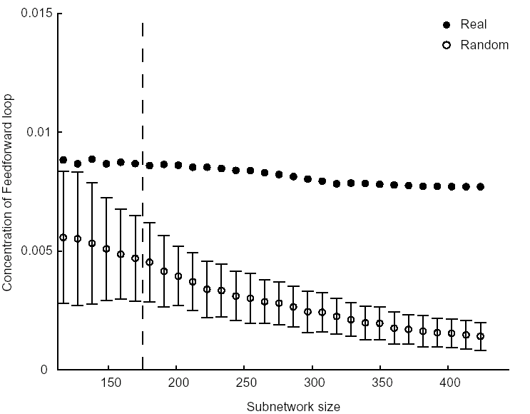
Concentration of feedforward motif:
(Num. appearances of motif divided by all 3 node connected subgraphs)
Mean+/-SD of 400 subnetworks

Slide 19
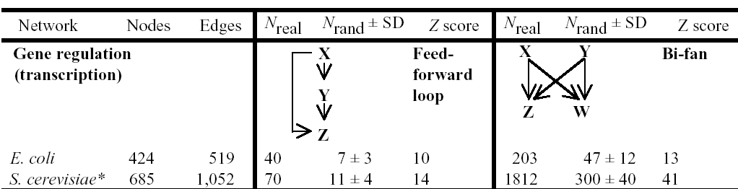
Transcriptional network results

Slide 20
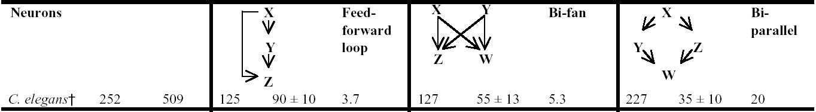
Neural networks

Slide 21
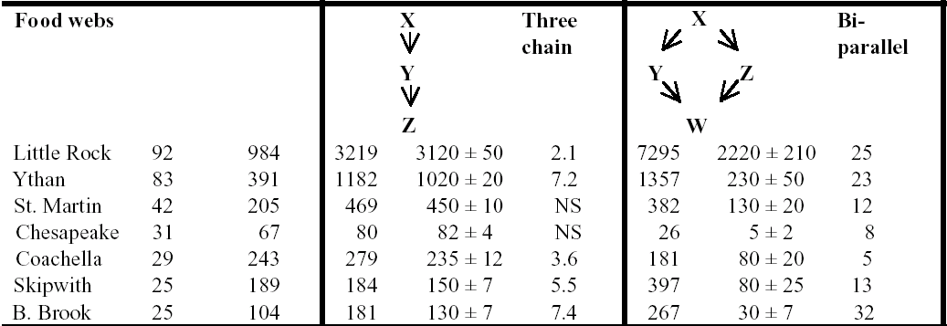
Food webs

Slide 22
Interesting questions
Which networks have motifs in common?
Which networks have completely distinct motifs versus the others?
Does this tell us anything about the design constraints on each network?
E.g., the feedforward loop may function to activate output only if the input signal is persistent (i.e., reject noisy or transient signals) and to allow rapid deactivation when the input turns off
E.g., food webs evolve to allow flow of energy from top to bottom (?!**!???), whereas transcriptional networks evolve to process information

Slide 23
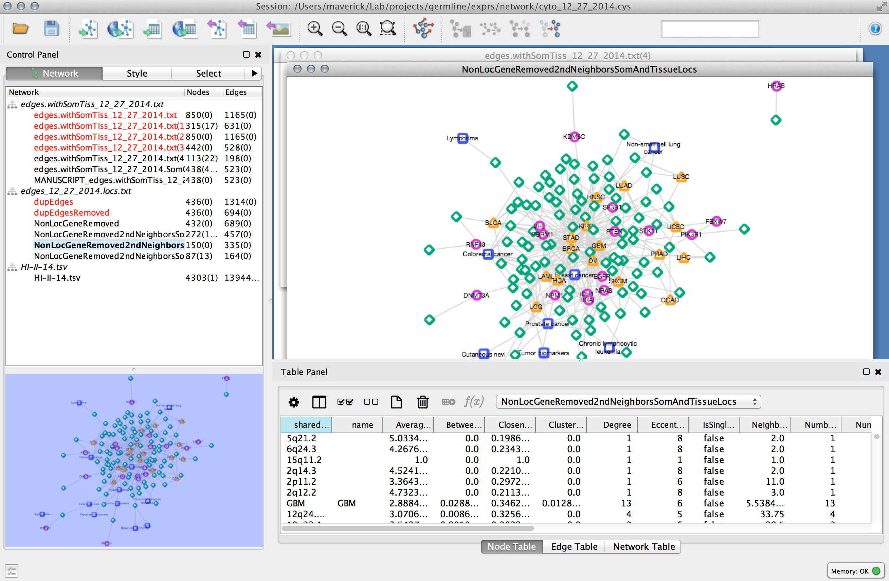

Visualizing / Analyzing Graphs
Cytoscape
iGraph (R)
NetworkX (Python)

Slide 24
Properties of Biological Networks
Scale Free
Generally see a small number of highly connected hubs and a much larger number of less connected nodes
Small world
Most nodes in biological networks are not that distant from one another
May have evolutionary significance
Guilt-by-association
Neighboring nodes in biological networks are usually involved in the same biological function

Slide 25
Examples of Biological Networks
Protein-protein interaction
Metabolic
Co-expression
Regulatory
Genetic Interaction
Difference Networks
Abstract

Slide 26
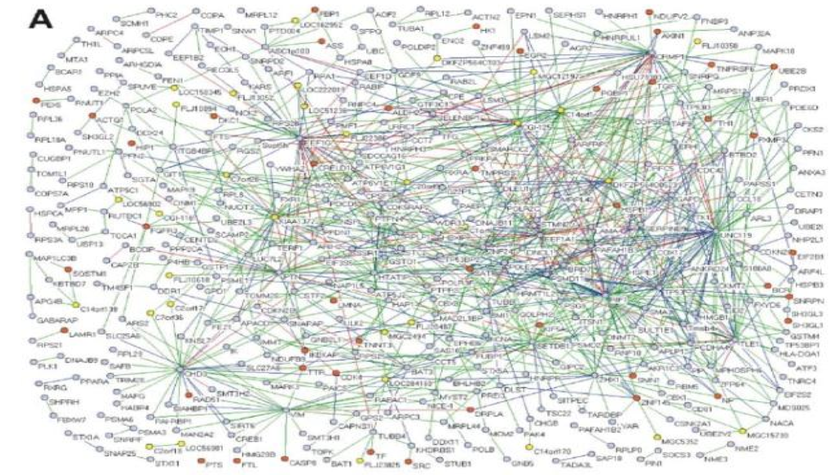
Protein Protein Interaction Network
Generated from Y2H data
MacArthur et al., PLoS ONE 3: e3086 (2008)

Slide 27
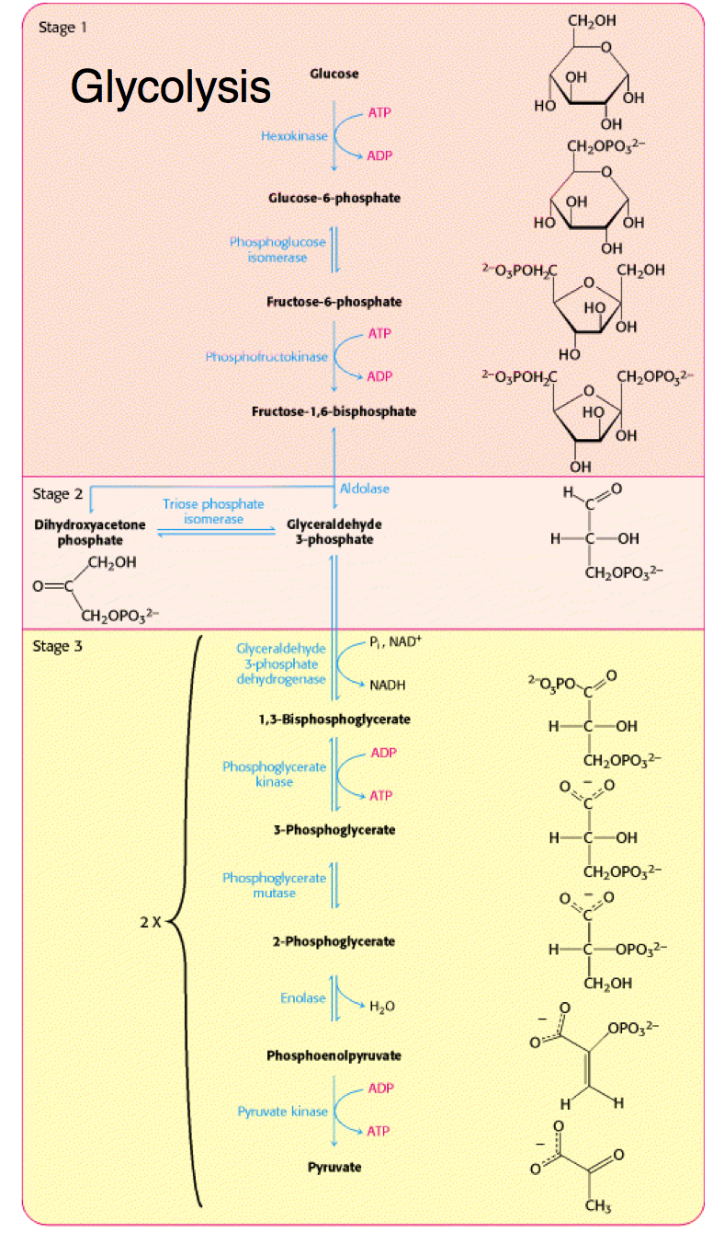
Metabolic Networks
Substrate
Reaction
Substrate
Reaction
Substrate

Slide 28
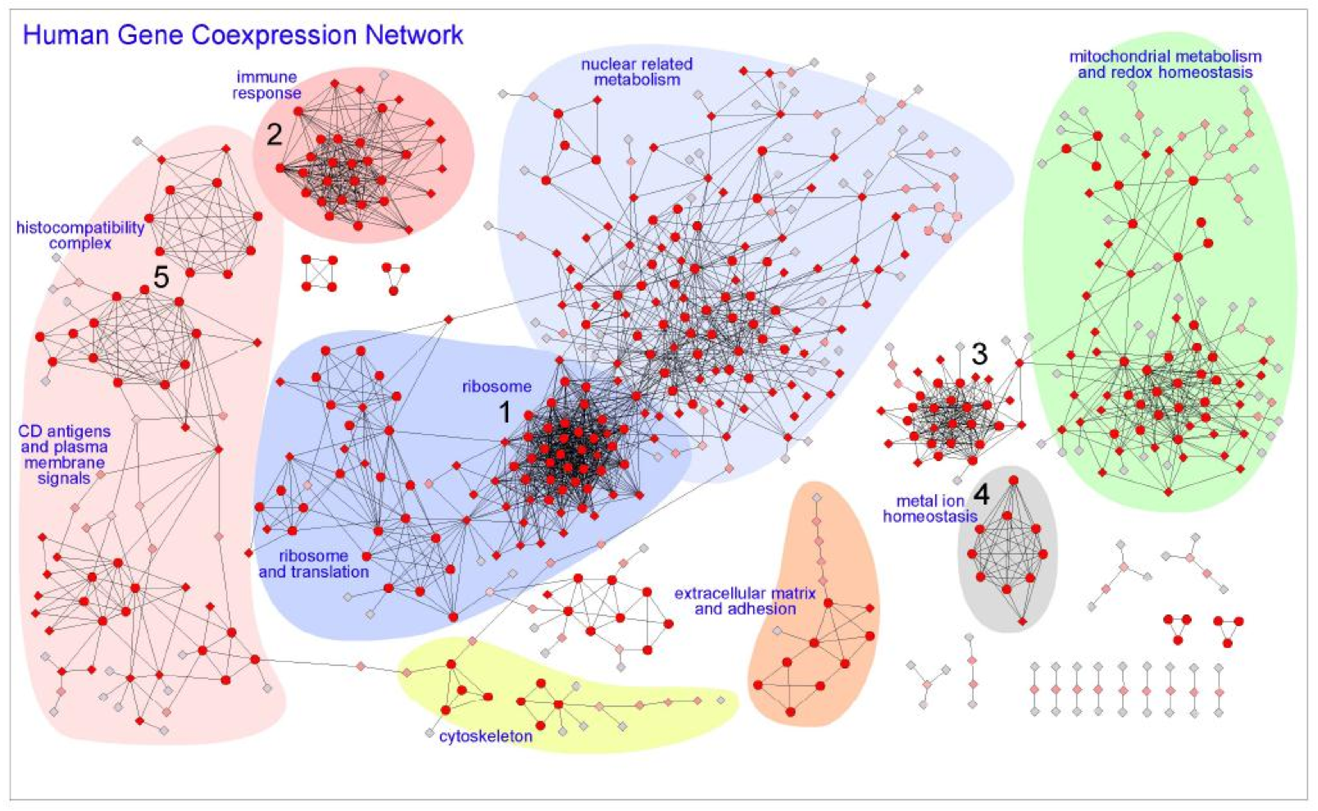
Hi-Fi Human Co-expression Network
Generated from microarrays on a panel of healthy normal tissues
3327 gene-nodes and 15841 coexpression-links
PLoS One. 2008

Slide 29
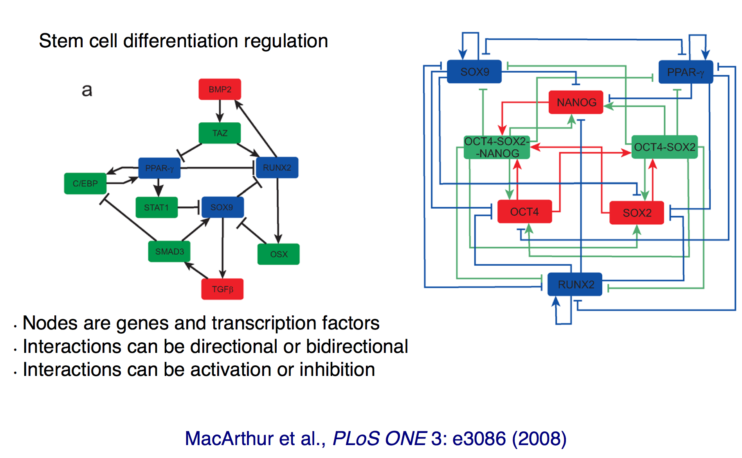
Gene Regulatory Network

Slide 30
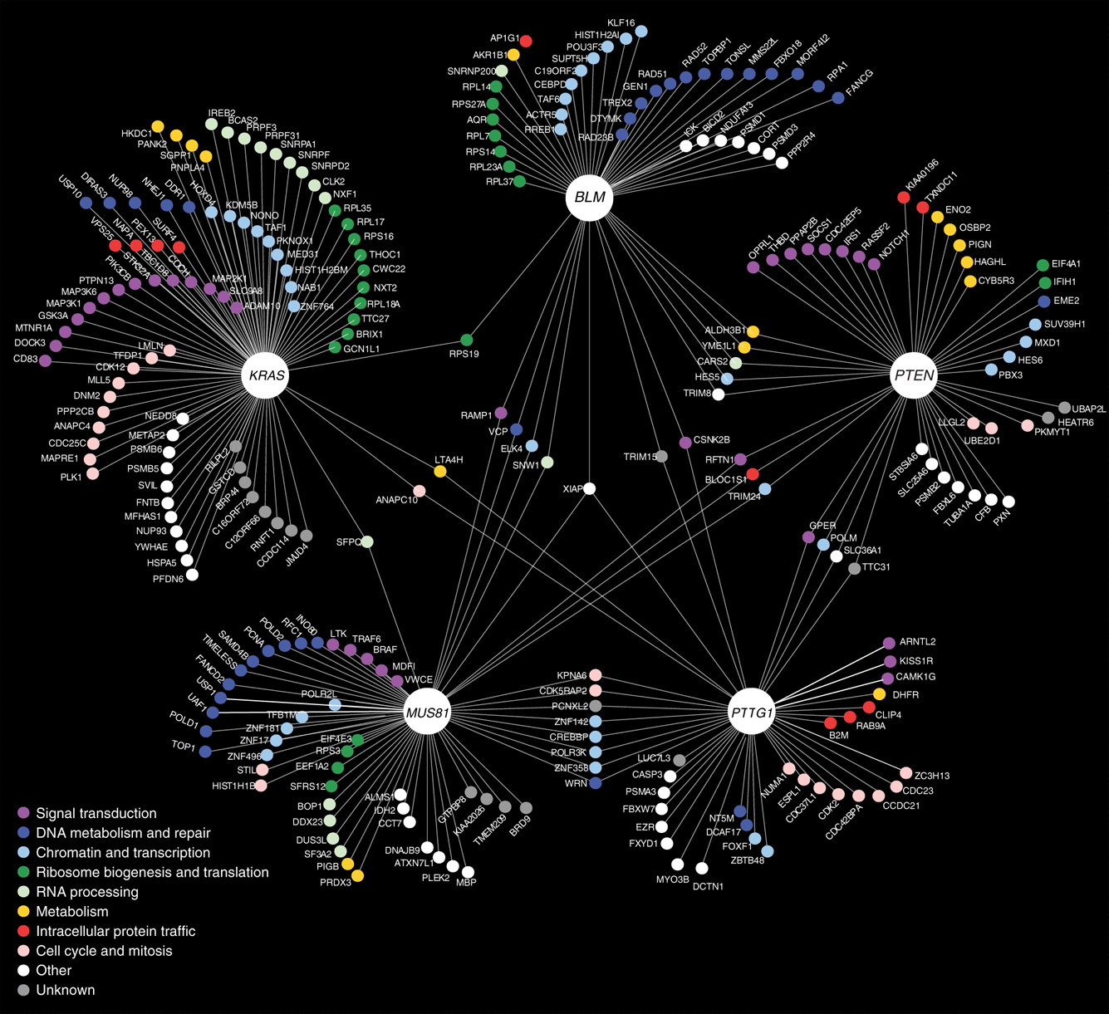
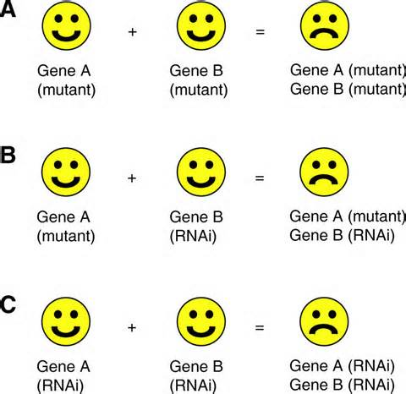
Genetic Interaction Network
Molecular Systems Biology (2013)
Application: Identify possible synthetic lethal interactions

Slide 31
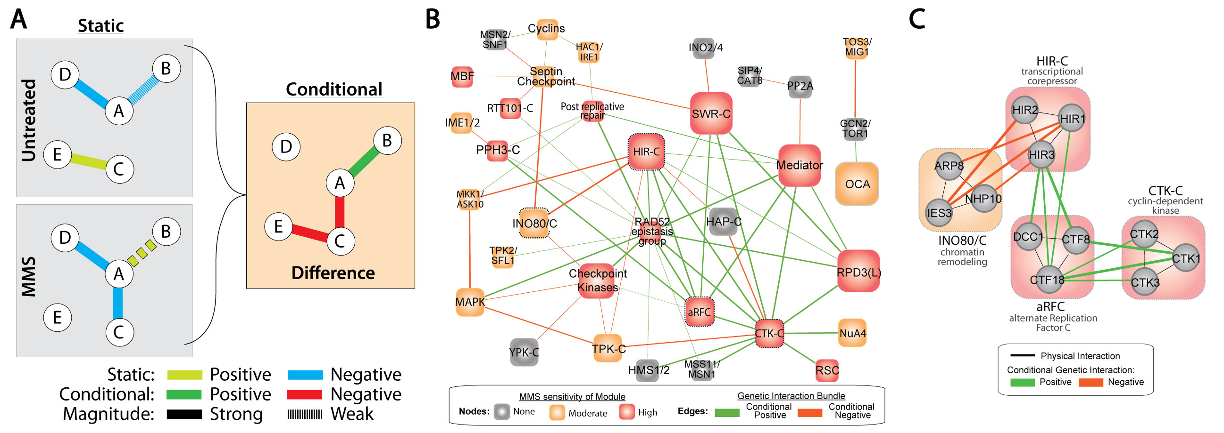
Difference Networks
Edges represent changes between different experimental conditions
Application: Compare how two distant species respond to a common stimulus

Slide 32
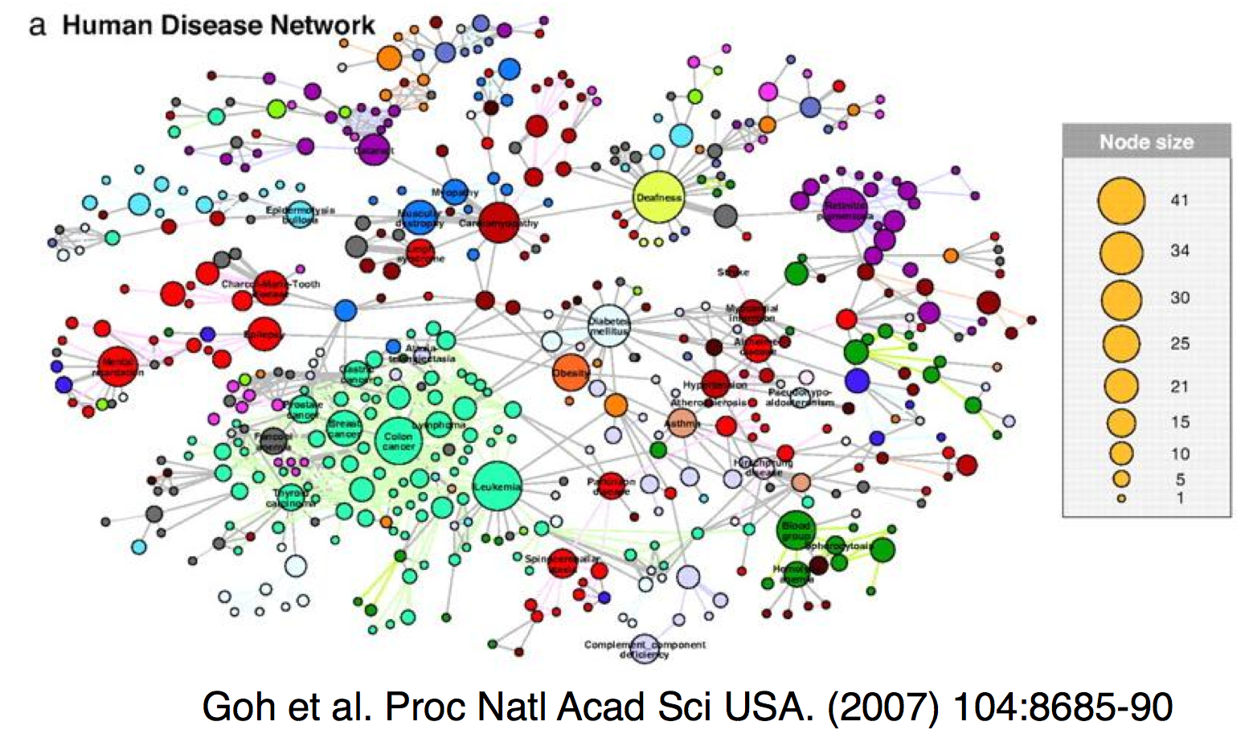
Diseaseome
Started from a bipartite graph
nodes represent genes and diseases
edges connect genes to diseases
Notes:
This is a collapsed view – diseases are linked by an edge if they share a gene. Node size corresponds to number of disease-associated genes

Slide 33
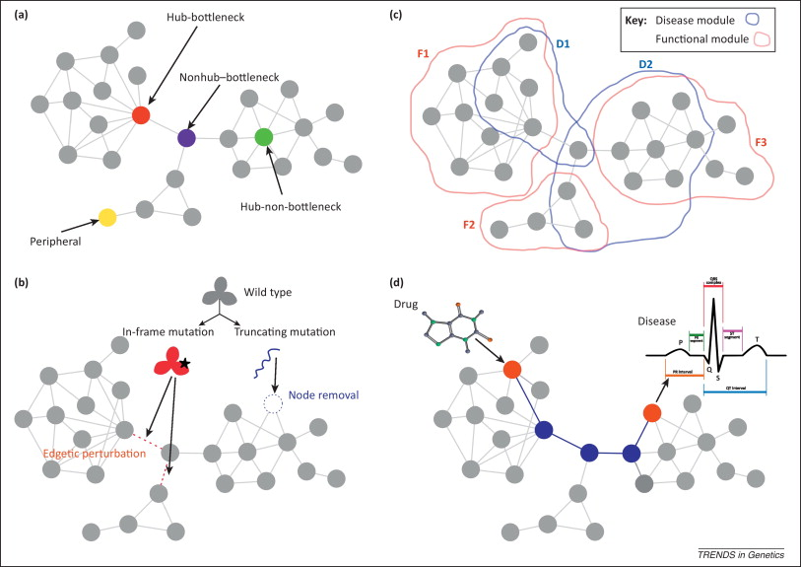
Network properties of human disease genes
Topology
Modularity
Perturbation
Environment
Furlong L. Human diseases through the lens of network biology Trends in Genetics 2013

Slide 34
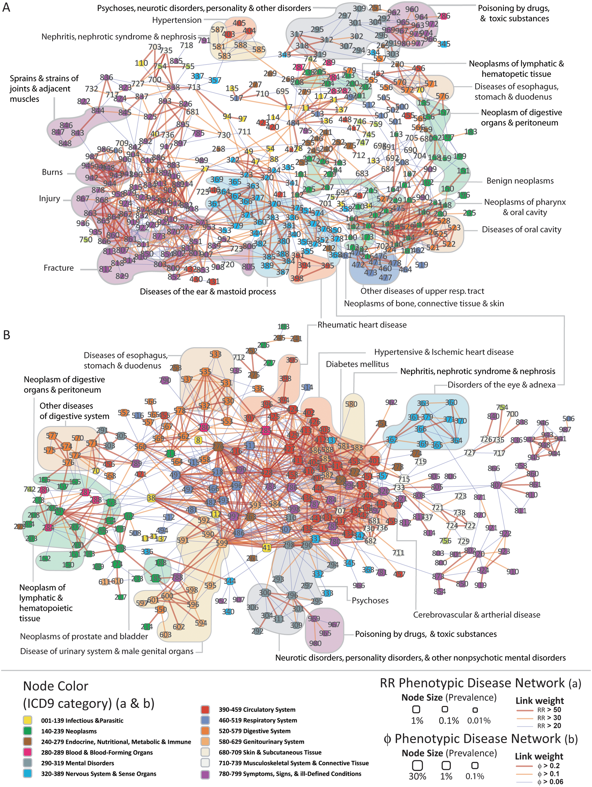
Phenotypic Disease Networks (PDNs).
correlations obtained from the disease history of more than 30 million patients
patients develop diseases close in the network to those they already have
the progression of disease is different for patients of different genders and ethnicities;
patients diagnosed with more highly connected diseases tend to die sooner
Hidalgo et al. PLoS Comp Bio 2009

Slide 35
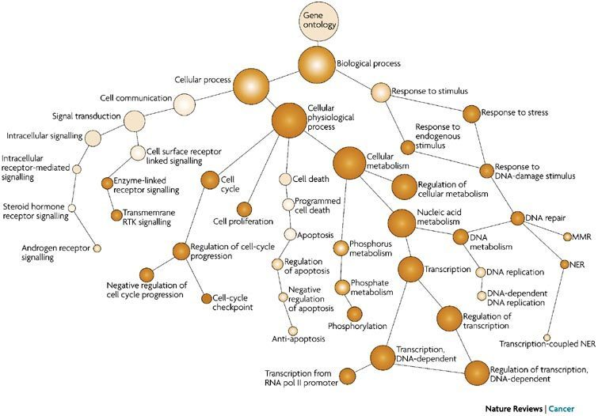
Ontologies
Define a hierarchy among objects
Gene Ontology (GO)
Curated from scientific literature
Other examples
Disease – symptom relationships
Organ – tissue – cell-type relationships

Slide 36
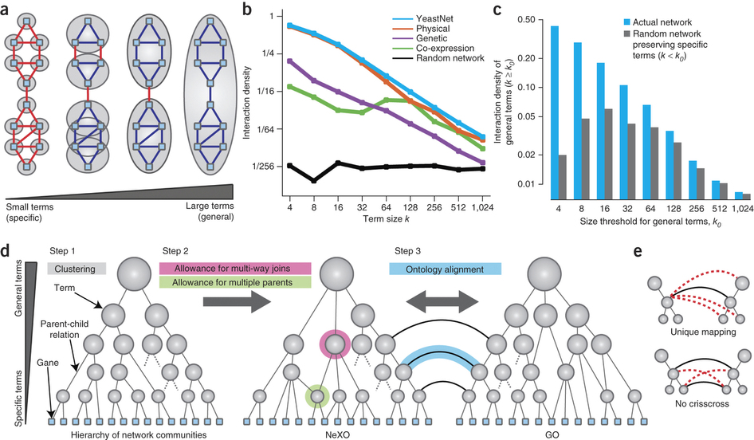
Constructing Ontologies from High-throughput Data

Slide 37
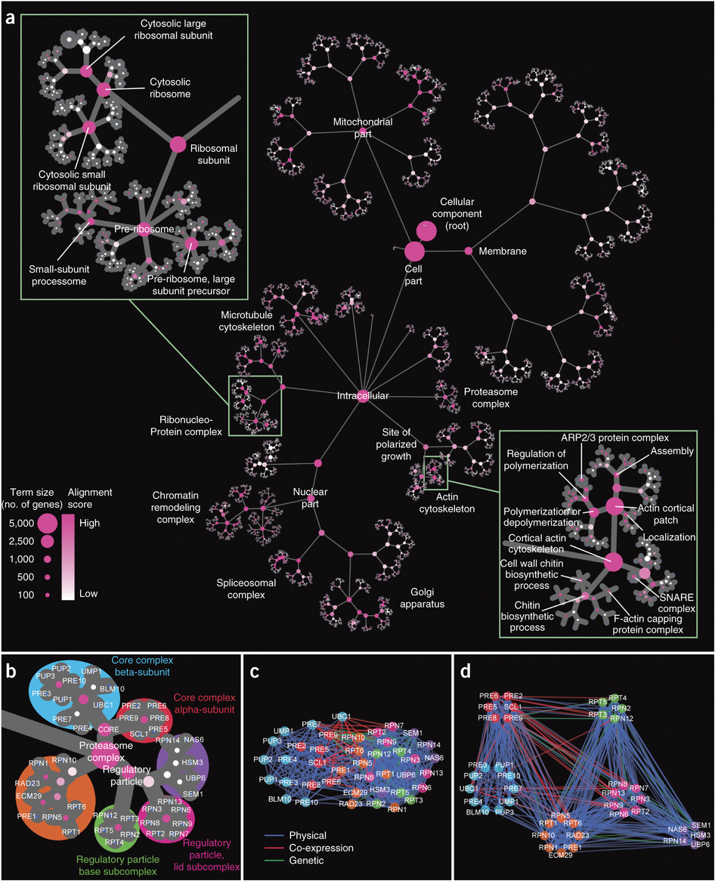
NEXO for Yeast
Nature Biotechnology (2013)

Slide 38
Sources for Biological Network Data
Literature
Interaction databases
STRING
MINT
HPRD
MIPS
BIND
GRID
DIP
HumanNet / YeastNet
Pathway Databases
Pathway Commons
Biogrid
NCBI PID
Reactome
Gene Ontology
High-throughput experiments
Y2H – binary interactions
APMS – protein complexes

Slide 39
Challenges in Biological Network Analysis
Incomplete data
We don’t have the tools to exhaustively measure the interactome
Static representation of a dynamic system
Even static representation may differ between environments
Biases inherent in how network was constructed
More studied proteins tend to have more interactions

Slide 40
Break

Slide 41
Networks and Variant Analysis
Network perturbation modeling
Network-based stratification

Slide 42
Network Perturbations
Experimental
Measure gene expression in the presence and absence of a perturbation
Generate a difference network
Computational
Use structurally resolved networks to analyze mutations
“edgetics”

Slide 43

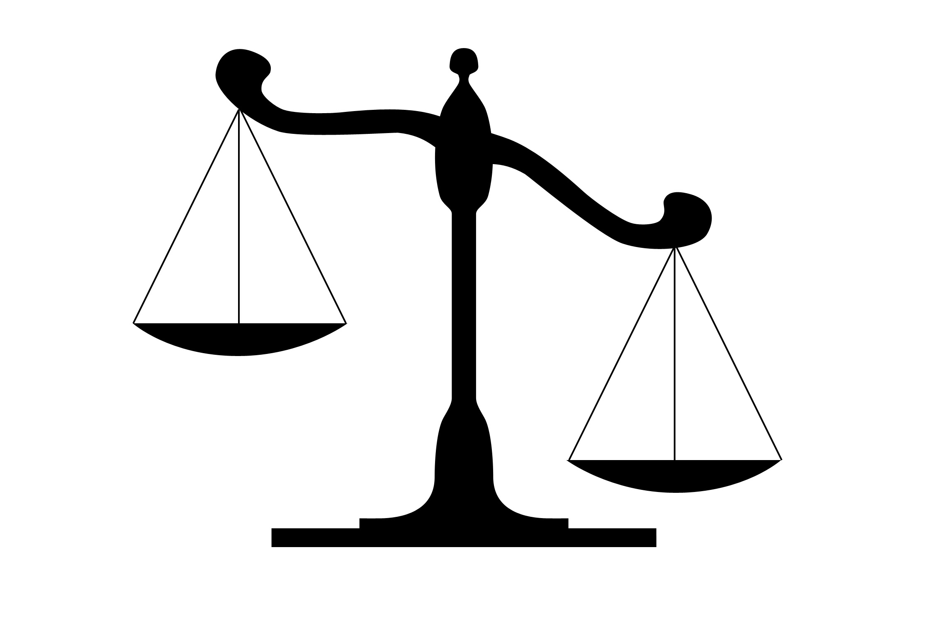
Cancer
Normal Tissues
Tumors
Cell Death
Cell Death
Cell Birth
Cell Birth
Accumulating genetic and epigenetic changes result in cancer by altering the balance between cell birth and cell death.
Notes:
Current model of cancer
Cancer results from an increase in the ratio of cell birth to cell death. This results from alterations to the cell’s genome.

Slide 44

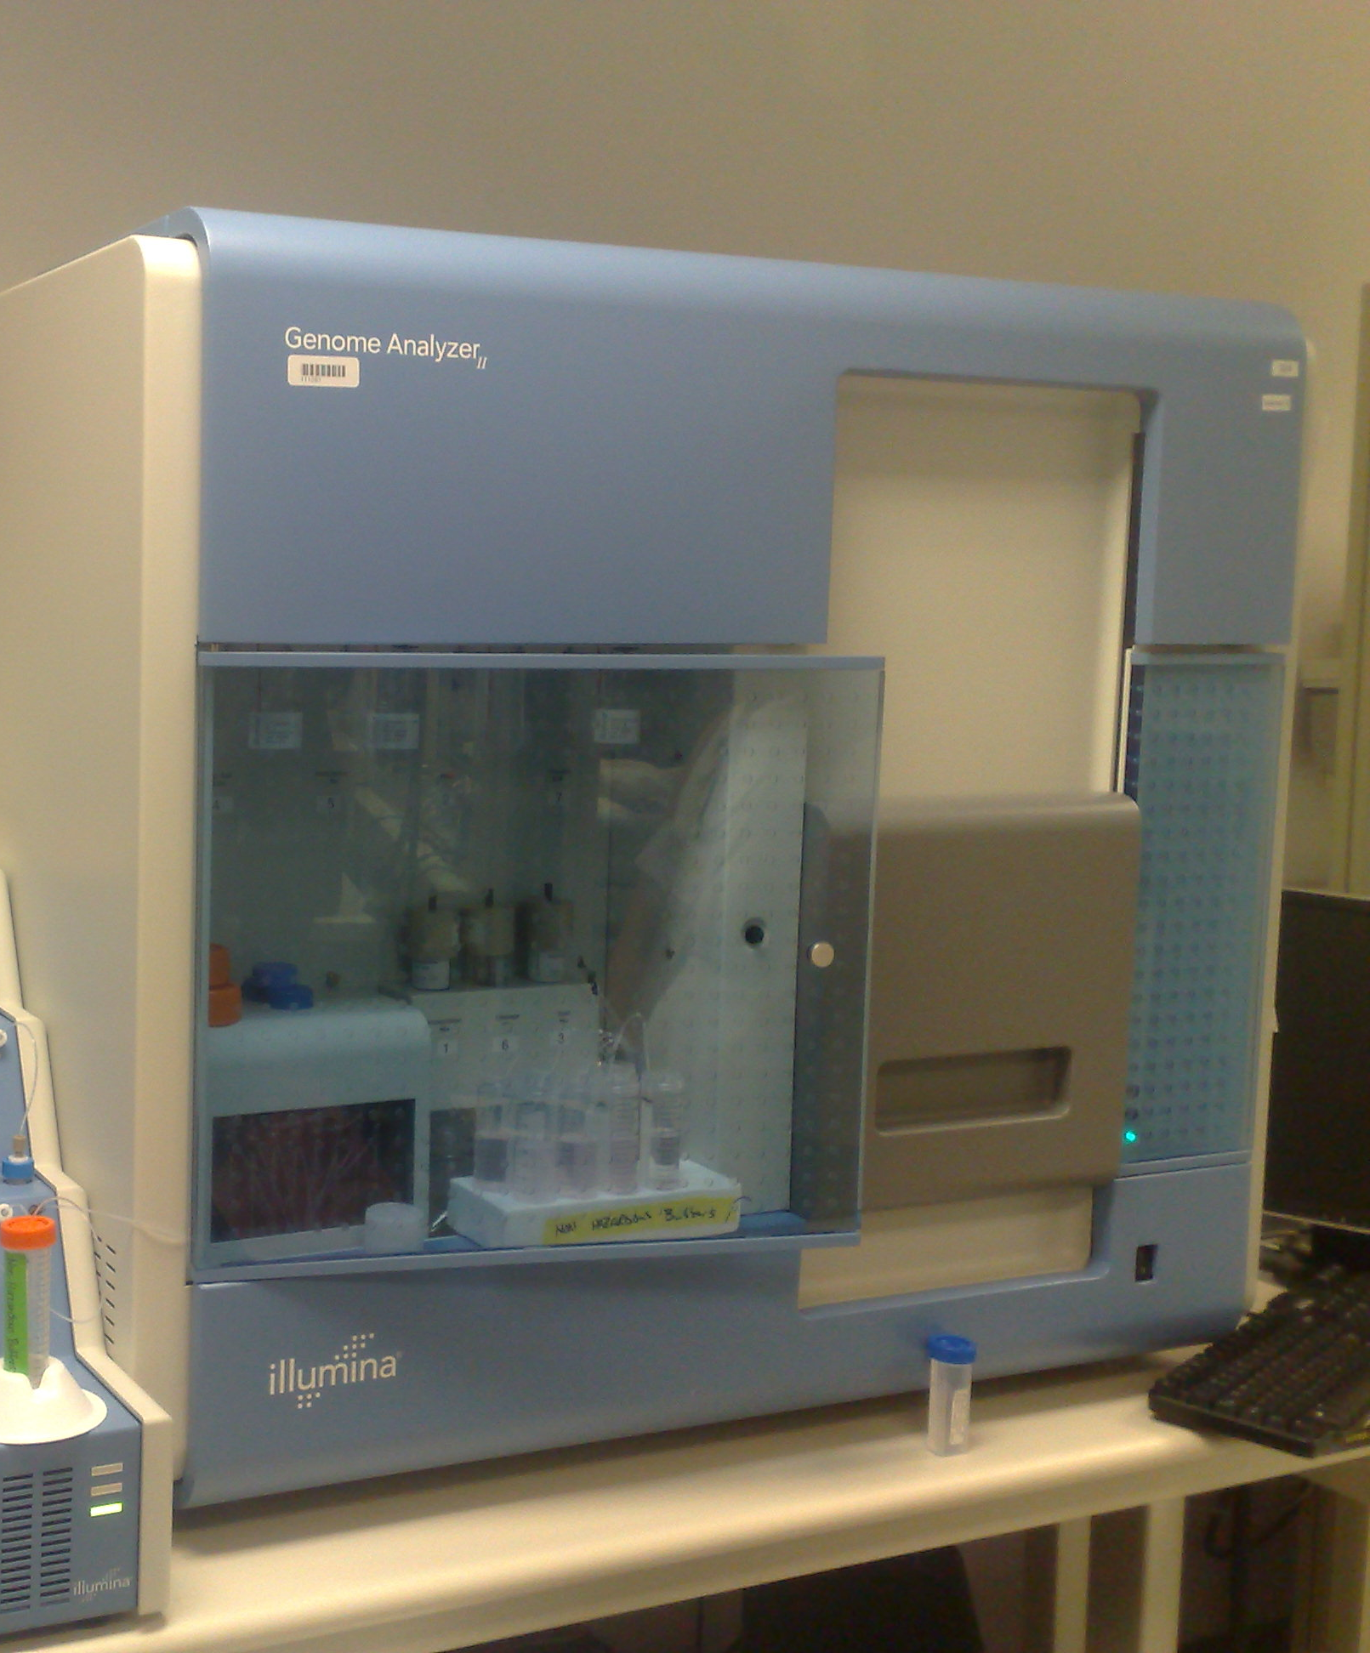

Detecting genetic changes in tumors with DNA sequencing
Tumor DNA
Normal DNA
Sequencing reads
Sequencing reads
Alignment to reference
Alignment to reference
MuTect
eBayes
Strelka
…
Compare
Somatic Mutations
Notes:
We can detect these changes through DNA sequencing – namely we sequence the tumor and normal genomes and look for sites where the tumor shows supporting evidence of a mutation but the germline does not.
Germline mutations can also contribute to cancer risk. The vast majority of known germline cancer mutations result in a higher mutation rate.

Slide 45

Somatic mutations uncovered by large-scale tumor sequencing
Tissue | Samples | Total Mutations | Missense | Silent | Nonsense | Nonstop | Splice | FrameShift | Muts/Samples
SKCM | 228 | 191967 | 117473 | 64243 | 7172 | 49 | 1835 | 1195 | 842
UCEC | 248 | 164832 | 110554 | 38550 | 11525 | 127 | 2569 | 1507 | 665
STAD | 220 | 107998 | 70652 | 29387 | 3548 | 72 | 1555 | 2784 | 491
COAD | 155 | 59332 | 39601 | 14487 | 3274 | 30 | 148 | 1792 | 383
LUAD | 248 | 92281 | 60561 | 22884 | 4805 | 58 | 1874 | 2099 | 372
LUSC | 177 | 63836 | 42529 | 15747 | 3682 | 55 | 1191 | 632 | 361
READ | 73 | 21229 | 14471 | 4629 | 1779 | 6 | 38 | 306 | 291
BLCA | 28 | 7187 | 4686 | 1826 | 418 | 9 | 115 | 133 | 257
CESC | 39 | 8909 | 5620 | 2532 | 474 | 11 | 93 | 179 | 228
HNSC | 306 | 56194 | 36253 | 14136 | 2885 | 53 | 924 | 1943 | 184
LGG | 217 | 25279 | 16460 | 6454 | 1024 | 13 | 453 | 875 | 116
KIRC | 297 | 23656 | 15594 | 5884 | 1076 | 21 | 495 | 586 | 80
GBM | 284 | 20589 | 13461 | 5229 | 809 | 11 | 339 | 740 | 72
KIRP | 114 | 7733 | 4829 | 1725 | 266 | 6 | 178 | 729 | 68
OV | 316 | 19233 | 13164 | 4231 | 800 | 16 | 426 | 596 | 61
PRAD | 83 | 4882 | 3041 | 1368 | 173 | 2 | 88 | 210 | 59
BRCA | 772 | 39427 | 25869 | 8733 | 1984 | 38 | 853 | 1950 | 51
THCA | 323 | 6526 | 4143 | 1573 | 194 | 4 | 125 | 487 | 20
LAML | 196 | 2170 | 1401 | 450 | 108 | 0 | 50 | 161 | 11
Notes:
Table doesn’t include inFrame indels

Slide 46

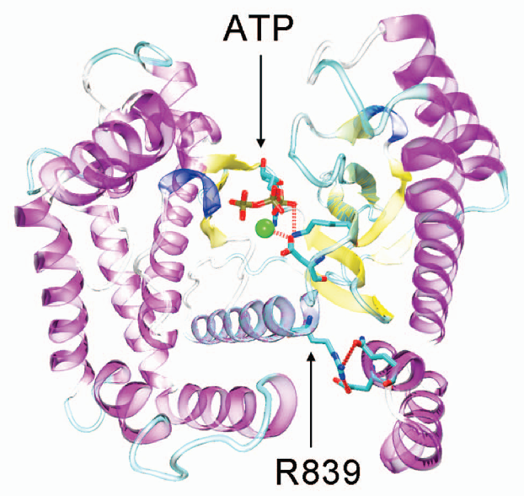
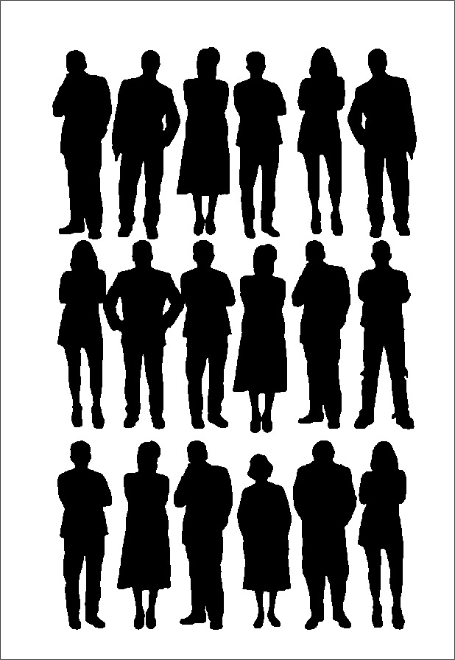
Identifying Driver Mutations in Cancer
VEST
Number of tumors out of 585
Carter et al. Cancer Biology and Therapy 2010
Tumor cohorts & cancer genes
Prioritizing missense mutations

Slide 47
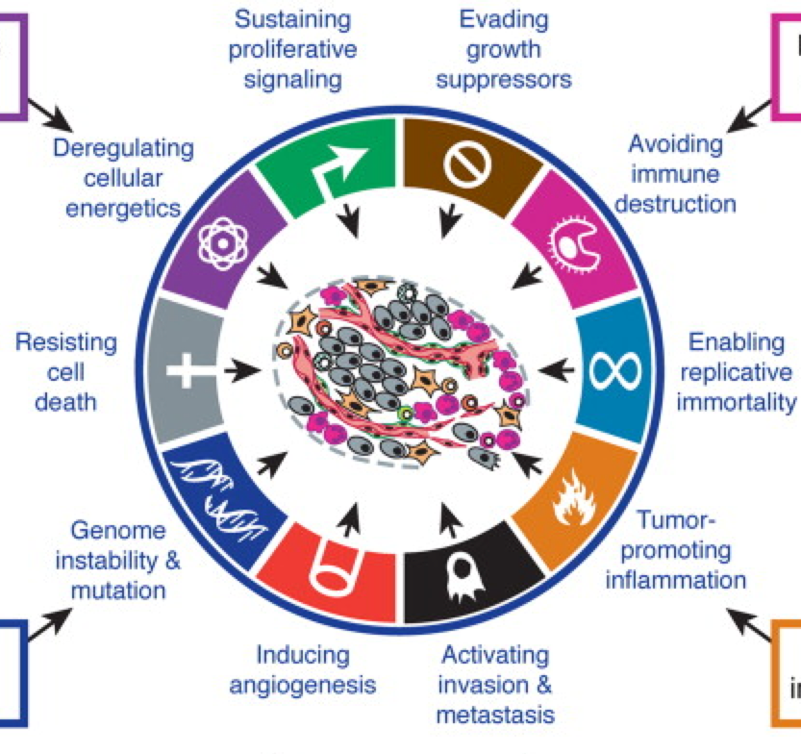
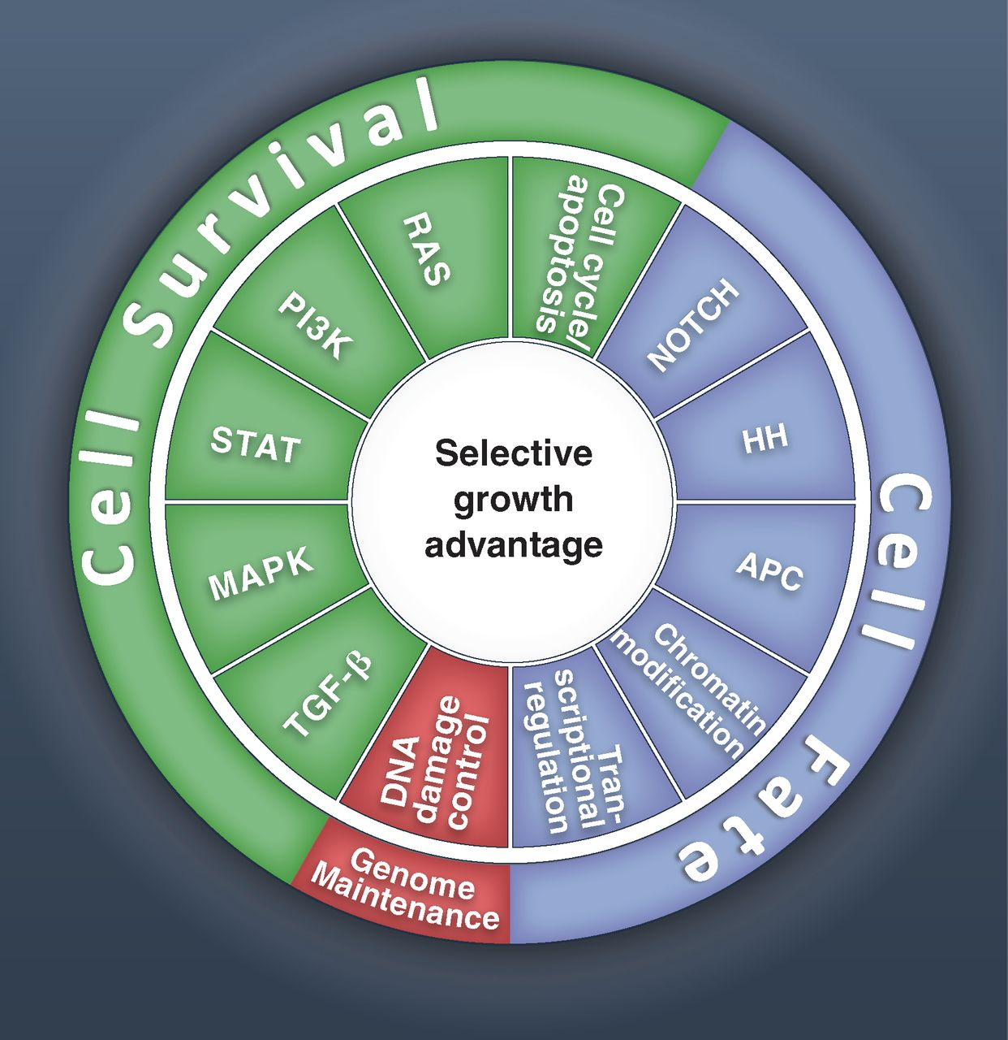
Phenotypic Characteristics of Tumors
Hanahan, Weinberg Hallmarks of Cancer: The Next Generation Cell Volume 144, Issue 5, 2011, 646 – 674
B Vogelstein et al. Cancer Genome Landscapes Science 2013, 339, 1546-1558

Slide 48
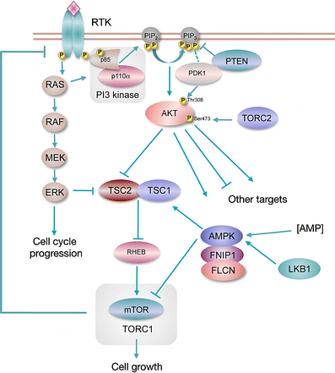
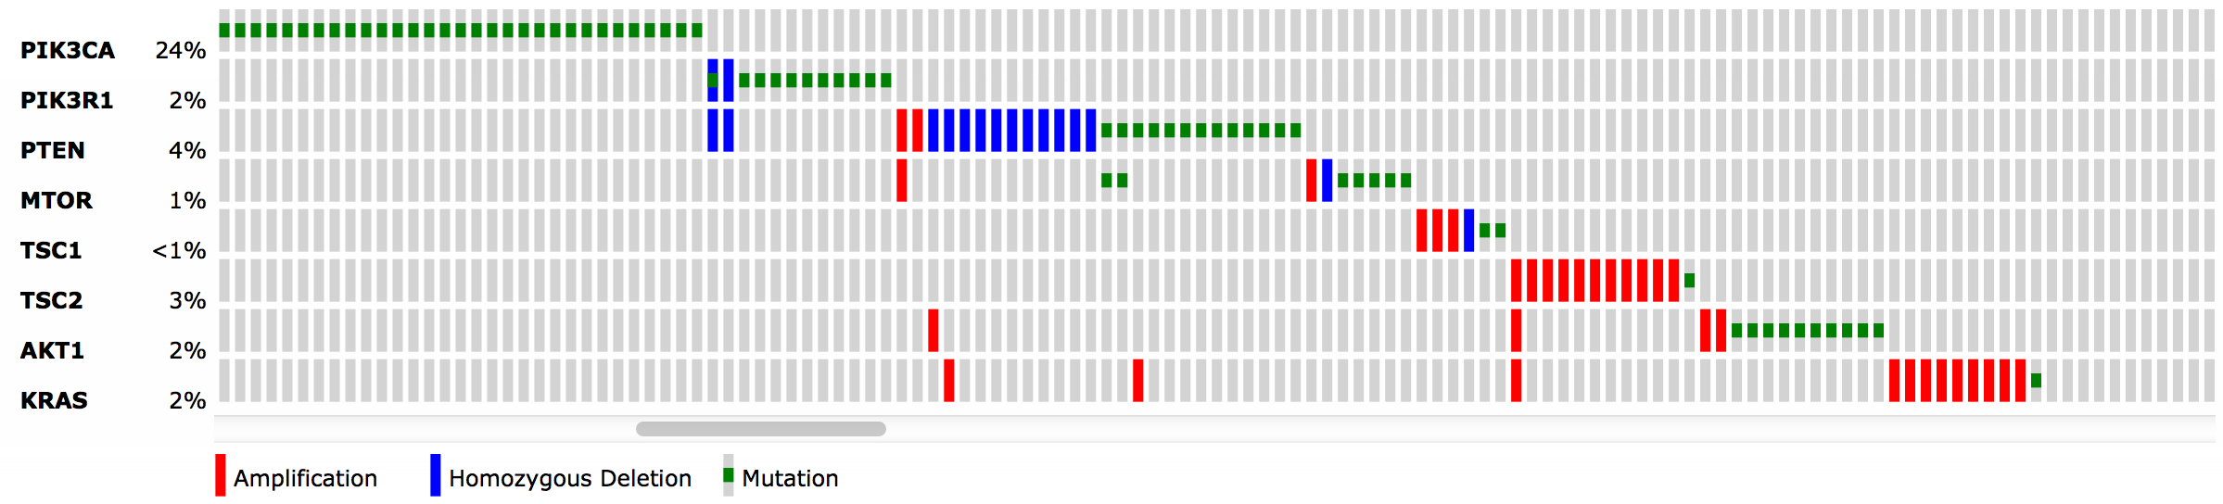
Mutual exclusivity within pathways
Knowles et al Phosphatidylinositol 3-kinase (PI3K) pathway activation in bladder cancer Cancer and Metastasis Reviews 2009
Breast Invasive Carcinoma (TCGA, Nature 2012)/All Tumors: (825)/User-defined List/8 genes
Notes:
To get this figure, typed names of genes in cbio portal for Nature 2012 BRCA cohort

Slide 49
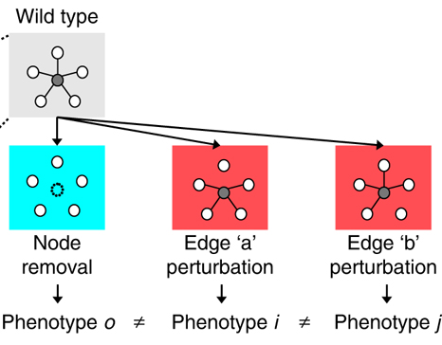
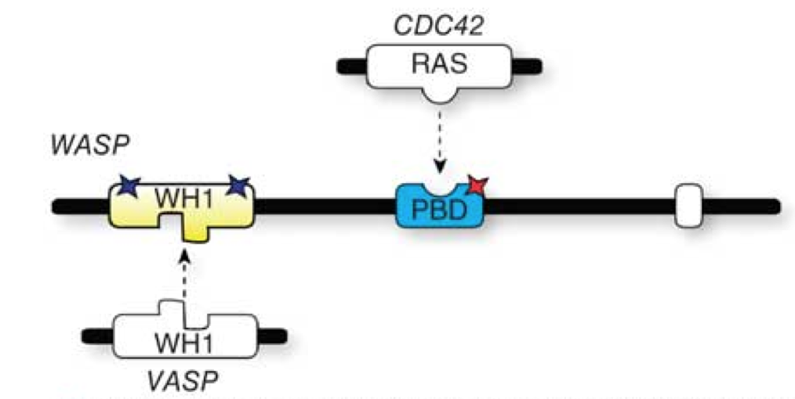
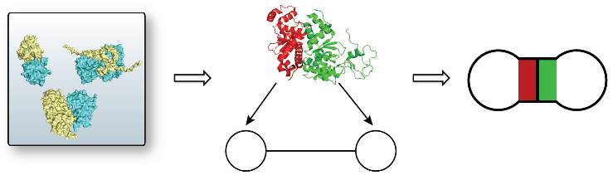
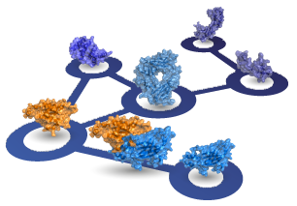
Lessons from Inherited Disease
Edgetic perturbations result in distinct phenotypes (Zhong et al., 2009 )
Disease causing nsSNPs are most enriched at core residues, followed by interface residues. (David et al., 2012)
In-frame disease mutations are enriched on the interfaces (Wang et al., 2012)
Pleiotropy (1 gene – multiple diseases)
Interactome3D (Mosca et al., 2013),
Instruct (Meyer et al., 2013)
Notes:
Mutations in CDC42 binding domain cause X-linked neutropenia
Mutations in VASP binding domain cause Wiskott Aldrich Syndrome and X-linked Thrombocytopenia
Let me begin with introducing you some key concepts related with protein structure. When a mutation occurs on the DNA, it may be carried to RNA and then to protein structure.

Slide 50

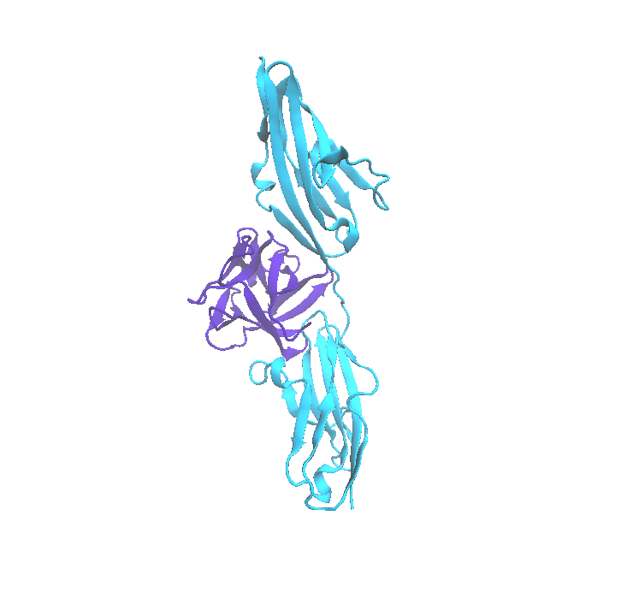
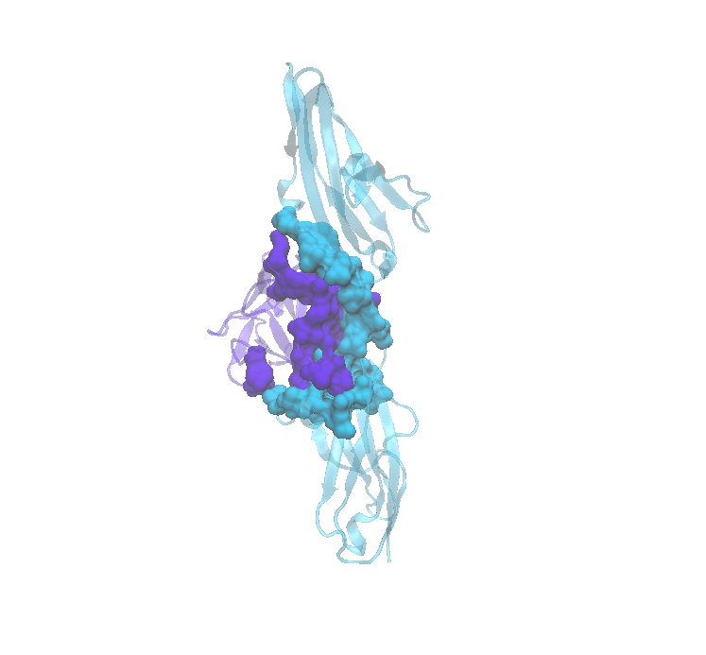
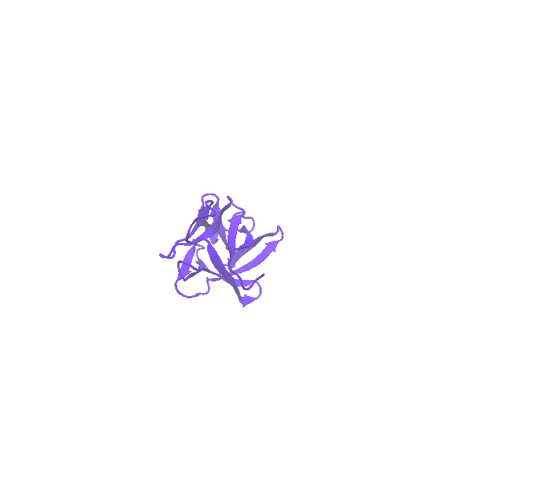
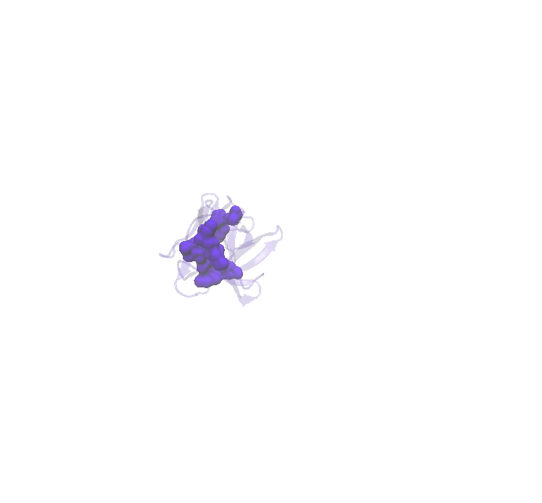
Mapping mutations to residues
Core Residues
Interface Residues
Billur Engin
FGFR1
FGF2
FGF2
Notes:
Here you see FGF2 protein’s structure. A given mutation may happen in one of the core residues or in one of the surface residues. Core residues are hydrophobic and are not exposed to outside, while surface residues are fully exposed to outside and hydrophilic. There are some intermediate residues, which are not fully buried or fully exposed. These residues may be concerned as core or surface in different PDB structures, so we defined an intermediate class for these residues.
Proteins team up together to pursue functions in the cell. Here you see FGF2 protein interacting with FGFR1 protein as an example. The physical contact region between two proteins are called “the interface”. The residues in the core are responsible for the stability of the protein, while the interface residues are important for maintaining the interaction. The energy distribution in the interface is not homogenous, there are some residues which contribute more to the binding free energy, These proteins are called hotspots. A mutation that would happen on a hotspot would most probably alter the interaction. Most of the PPI targeting drugs bind to hotspot residues to hinder the protein interaction.

Slide 51
Analysis of Cancer Mutations in Driver Genes using a Hybrid PPI Network
Human PPI network (STRING, HINT, PDB) : 11943 proteins, 74558 PPIs
Structural data from PDB for 125 driver genes (Vogelstein et al., 2013)
97 proteins , 147 complexes
TCGA data 28 types of tumor tissue, 399 of mutations mapped to PDB structures, 1094 of patients
Notes:
kac hasta var tcga’de normalde

Slide 52
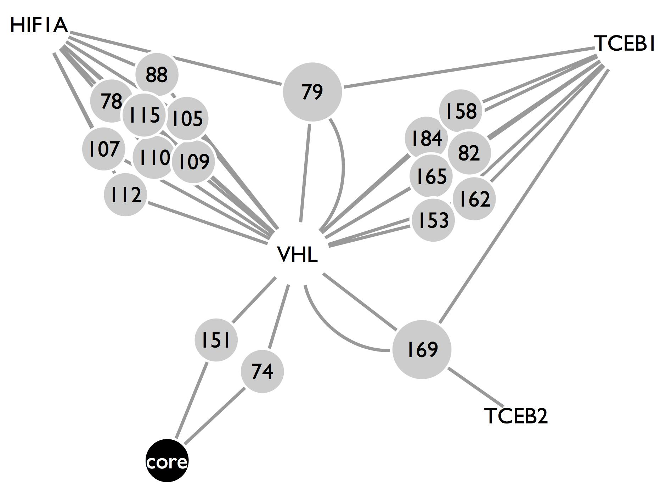
137 distinct core or protein interface localized mutation clusters

Slide 53
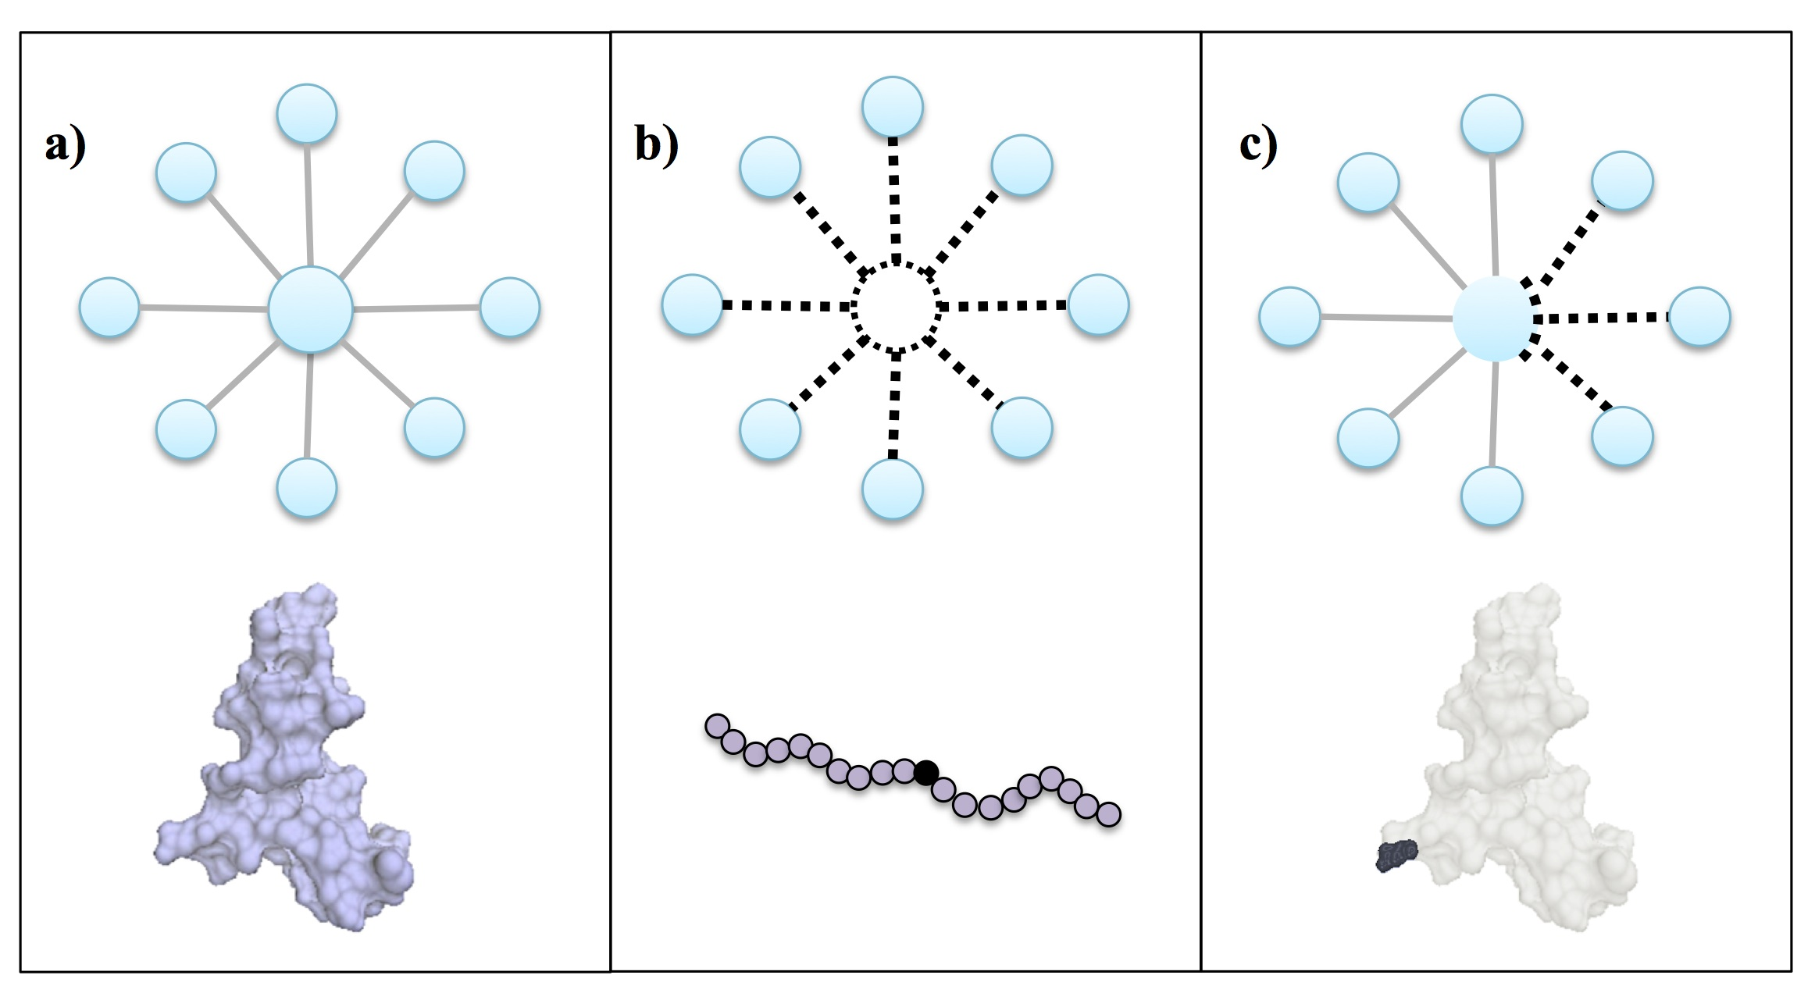
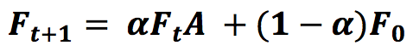
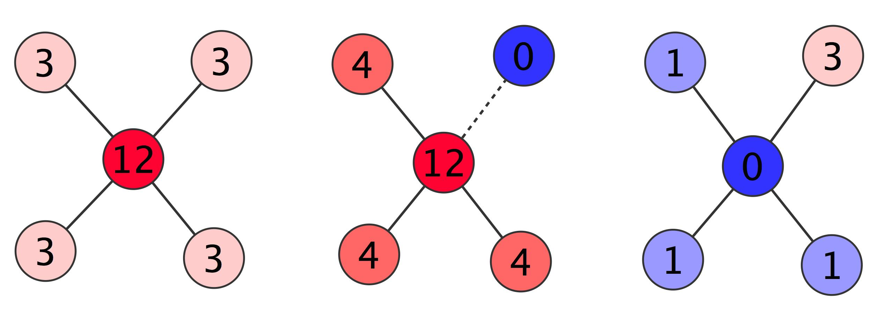
Pipeline for annotating mutations
Network Perturbation
Network Propagation
Wild Type
Core mut.
Interface mut.
*
Sub-network Extraction
Δ heat = wild (F) –perturbed (F)
Functional Annotation
Original network
Perturbed
Network
Δ heat
* (Vanunu et al., 2010; Hofree et al.,2013)
Engin et al., PSB 2015
Notes:
Iterate until saturation – evalue (difference between heat values is 10⁻⁶)
Min (P1, P2) – assign to edge
Top 10th percentile - keep
1000 random (core + interface muts) – remove edges that are consistently hot
1 gene-set per mutation – Avg of 76 connected components - annotate each separately, and focus on distinct functionality

Slide 54
43 Proteins with mutations at distinct sites
Genes | # of Distinct Mutations | Genes | # of Distinct Mutations
CTNNB1 | 11 | SMAD4 | 2
APC | 7 | CASP8 | 2
PPP2R1A | 6 | ABL1 | 2
EGFR | 6 | FLT3 | 2
TP53 | 6 | PIK3CA | 2
VHL | 5 | CSF1R | 2
DAXX | 5 | KDM6A | 2
FGFR2 | 5 | CDH1 | 2
B2M | 4 | FBXW7 | 2
RB1 | 4 | CDKN2A | 2
MSH2 | 3 | MSH6 | 2
MEN1 | 3 | BCOR | 2
SMAD2 | 3 | ATRX | 2
DNMT3A | 3 | FGFR3 | 2
AXIN1 | 3 | MLL3 | 2
PIK3R1 | 3 | ERBB2 | 2
HRAS | 3 | PTPN11 | 2
BRCA1 | 3 | KIT | 2
H3F3A | 3 | MET | 2
SPOP | 3 | RUNX1 | 2
NOTCH1 | 3 | CREBBP | 2
CBL | 3
Functional annotations of the residue mutations of 5 proteins were validated via literature
Engin et al., PSB 2015
Notes:
Min (P1, P2)
Top 10th percentile
1000 random (core + interface muts)
1 gene-set per mutation

Slide 55


HRAS Case Study
Engin et al., PSB 2015
Notes:
Structural coverage is poor, We still see some distinct mutation effects

Slide 56
HRAS Case Study
(Chin et al., 1999; O'Hayer et al., 2009; Carmeliet et al., 2000)
HRAS^{G12V}
Chemokine signaling
(Prior et al., 2012; Tormanen et al., 1992)
VEGF activation
UV radiation targets have a bias to cause Q61 mutations
Endothelial Cell
Apoptosis
Skin Cancer
HRAS^{Q61}
HRAS^{G12V} is essentail
For maintanence of
solid tumors
(Pylayeva-Gupta et al., 2011)
activation
HRAS^{G12V}
GPCR
weaker GTPase activity and stronger binding to GTP
HRAS
HRAS^{G12D}
SOS1
GPCR Signaling
Smooth Muscle Cells
Blood Coagulation
Endothelial cells
GTPase activity
Vasculogenesis
Cytokines
Response to UV
Engin et al., PSB 2015
Notes:
Vascular smooth muscle cells provides homeostatic control and protect newly formed vessels against rupture or regression via inhibition of endothelial cell proliferation and migration
Chemokines play an important role in the behavior of endothelial cells during vessel formation
Inappropriate blood coagulation is Observed in cancer patients
vasculogenesis is related with proliferation, migration and remodeling of endothelial cells, and have been found to be related with tumor recurrence

Slide 57




Translational Implications (494 patients)
Remove Specific Edges
Remove All Edges
P < 0.0005
P < 0.02
p = 0.000224
Notes:
Reduced number of patients for survival curves (494)
Consensus clustering – K=5 based on the elbow methods
GBM, Thyroid, Prostate patients and patients older than 75 years filtered
500 patients (differential structural mutations + RNAseq data in TCGA)

Slide 58
Large-scale Analysis of Cancer Mutations using a Structurally Resolved PPI Network
~ 2 million somatic mutations
Amino acid residues mapped to protien interactions using co-crystal structures in the PDB
Novel representation as a bipartite protein-residue interaction network

Slide 59


Slide 60

Somatic Mutations are Enriched at PPI Interfaces

Slide 61

Somatic Mutations rewire the MCH I Antigen Presentation Pathway
All interface residues
Mutated interface residues

Slide 62

Prognostic Implications of TP53 Mutations Stratified by Interface

Slide 63
Network-based Patient Stratification (NBS)
Molecular Profiles
Patients
Mutations are too sparse for effectively clustering samples
Hofree et al, Nature Methods 2013
Notes:
Project that I came into halfway through

Slide 64

A subway map of cancer pathways
Hahn and Weinberg. Nat Rev Cancer 2002

Slide 65

Network-Based Stratification (NBS)
Hofree et al, Nature Methods 2013
Notes:
NMF with a penalty designed – find a solution that respects the network topology

Slide 66

An intuition for network smoothing
Genotype A:
[…,0,0,1,0,0,1,0,0,0,0,0,0,0,0,0,1,0,0…]
Genotype B:
[…,0,0,1,0,0,0,0,0,0,1,0,0,0,0,0,0,0,0…]
Genotype A: […,0,0.1,1,0.2,0.1,1,0,0,0,0.2,0,0,0,0.1,0,1,0,0…]
Genotype B:
[…,0,0,1,0.1,0.1,0,0,0,0.2,1,0,0,0,0,0,0,0.2,0…]
Genotype A: […,0,0.2,1,0.3,0.2,1,0,0,0,0.2,0,0,0,0.3,0,1,0.1,0…]
Genotype B:
[…,0,0.1,1,0.3,0.4,0,0,0,0.4,1,0,0,0,0,0.1,0.1,0.5,0…]
Genotype A: […,0,0.3,1,0.4,0.4,1,0.1,0,0,0.3,0,0,0,0.4,0,1,0.2,0…]
Genotype B: […,0,0.3,1,0.2,0.4,0.1,0,0,0.4,1,0,0,0,0,0.2,0.2,0.5,0…]
Genotype A: […,0,0.3,1,0.4,0.4,1,0.2,0,0,0.3,0,0,0,0.4,0,1,0.2,0…]
Genotype B: […,0,0.3,1,0.2,0.4,0.2,0,0,0.4,1,0,0,0,0,0.2,0.4,0.5,0…]

Slide 67
An intuition for network smoothing
Genotype A: […,0,0.3,1,0.4,0.4,1,0.2,0,0,0.3,0,0,0,0.4,0,1,0.2,0…]
Genotype B: […,0,0.3,1,0.2,0.4,0.2,0,0,0.4,1,0,0,0,0,0.2,0.4,0.5,0…]

Slide 68
Network-Based Stratification (NBS)
Molecular Profiles
Patients
Pathway Activities
Hofree et al, Nature Methods 2013
Notes:
Molecular profiling

Slide 69
Network-Based Stratification (NBS)
Molecular Profiles
Patients
Pathway Activities
Prognoses
Hofree et al, Nature Methods 2013
Notes:
Molecular profiling

Slide 70
Network-Based Stratification (NBS)
Molecular Profiles
Patients
Pathway Activities
Prognoses
Therapeutic Responses
Drug A
Drug B
Drug C
Hofree et al, Nature Methods 2013
Notes:
Molecular profiling

Slide 72
Networks And Gene Expression
Map gene expression onto nodes in the network
Identify regions of the network enriched for differentially expressed genes

Slide 73
Need a scoring system for expression activity
Each node in the network assigned a differential expression fold-change (usually log scale) and significance (p-value)
Can generate an aggregate z-score for a set of nodes
Expression fold-changes can be misleading

Slide 74
Analysis of gene expression with pathway scores
Zien, Kuffner, Zimmer, Lengauer (2000) originally proposed a method for scoring gene expression activity of a given metabolic reaction pathway P:
S(G) is a p-value of differential expression or an average correlation coefficient vs. genes in P
More recently, statistics have been modified to use z-scores

Slide 75
Searching for “active” pathways in a large network
Score subnetworks according to their overall amount of activity
Finding the highest scoring subnetworks is NP hard, so we use heuristic search algs. to identify a collection of high-scoring subnetworks (local optima)
Simulated annealing and/or greedy search starting from an initial subnetwork “seed”
During the search we must also worry about issues such as local topology and whether a subnetwork’s score is higher than would be expected at random
Notes:
So now that we have a scoring system, we can turn to the problem of finding the high-scoring pathways themselves.

Slide 76
Exercises
Network Basics with iGraph
Cytoscape walkthrough

